Slide 1
Blinded by the Light: Artificial Light Lowers Mate Attraction Success in Female Glow-Worms (Lampyris noctiluca L.)₁
by Mira Van den Broeck, Raphaël De Cock , Stefan Van Dongen and Erik Matthysen
CSE713: Individual Presentation
Group No-12
ST: Ehsanur Rahman Rhythm
RA: Md Sabbir Hossain
Individual Presenter :
Nazia Parvin 23166034
Submitted To:
Annajiat Alim Rasel
Senior Lecturer, Department of Computer Science and Engineering,
Brac University.

Slide 2
Introduction
Artificial light at night (ALAN) is a globally occurring threat to wildlife, which has emerged relatively recently with the expansion of human industrialisation and is currently still increasing worldwide by 6% every year
A particular group of nocturnal animals that are especially vulnerable to artificial light are the bioluminescent glow-worms and fireflies (Lampyridae), due to their light based signals for mating
Studies have found that artificial lights has caused reduced circadian glowing activity in female glow-worm and as they have short mating period and many of them die without mating, which eventually decreases the population of glow-worms.
In this study individual females daily were monitored in artificially lit and unlit surroundings, covering an entire mating season, to test whether street lighting (low pressure sodium (LPS); monochromatic orange) reduces female mate-attraction success

Slide 3
Methods and Materials
Study:
The study was done in two forests in Lippelo, Belgium and the places were bordered with LPS (low pressure sodium)streetlighting as well as unlit roads.
Light Environment:
Adult female glow-worms were monitored both in dark areas and areas illuminated to a varying degree by LPS streetlights.
Study Species:
The study was conducted on glow worms that are found widespread in Flanders,Belgium. Glowing status of the female was used as proxy.
They exchanged the original environment of the glow worms, where they were born, in between dark and artificially lighted environments to identify the changes.
Monitoring:
The glowing status of individual females was checked every night between 26 June and 13 July 2019, between 10.00 P.M.–12:00 A.M., which corresponds to their natural glowing period and marked them with white dot.

Slide 4
Methods and Materials
Statistics:
The statistical analysis was performed using R.
A survival analysis was performed using the survival package and survminer package.
The survival analysis allowed us to take into account censored data of females that were still glowing by the end of the monitoring period, and also allowed to include females that entered the experiment at different times
A female was considered to have stopped glowing when she was not seen aglow for a minimum of two consecutive days

Slide 5
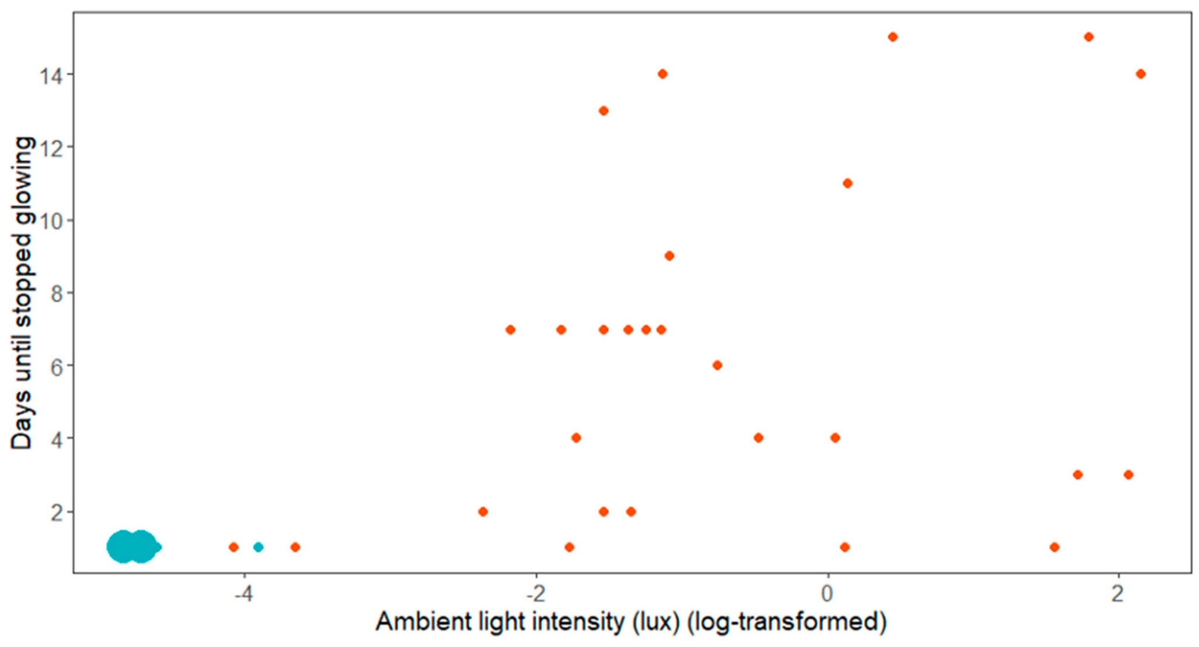
Experimental Result
The females which were located in dark areas all stopped glowing after one day (n = 24, including 4 females found in situ, 12 females raised in captivity, and 8 females translocated from lit areas),
Whereas the females in illuminated areas glowed for a longer period with a median of 6 consecutive nights (range 1 to 15, n = 27, 15 females found in situ, 11 females raised in captivity and 1 female translocated from a lit area).
Figure 1. Observed time until mating (using cessation of glowing as a proxy) in relation to light conditions. Blue dots are the females in dark areas and red dots are the females in illuminated areas. The size of the dots reflects the number of individuals. Note that not all females were monitored until they ceased glowing. The two large dots in the lower left corner represent 22 females (Ntot = 51).

Slide 6
Discussion
Daily monitoring of female glow-worms revealed that females exposed to LPS streetlighting glowed for significantly more nights than females located in natural darkness.
The survival analysis confirmed that female origin had no impact on the relation between light environment and time to mating
Females located in illuminated areas glowed for many more nights, which can be explained by several non-mutually exclusive hypotheses including
(1) repulsion (males are repulsed by light of high intensity),
(2) light adaptation (bright lights decreases male visual sensitivity), or
(3) the wash-out effect (female signals are invisible to males due to a decreased contrast with their surroundings
In a word, artificial light can reduce the population of glow worms and in this regard the most efficient solution would be to turn off, reduce or shield outdoor lighting near ecologically vulnerable areas, in particular for the comparatively short duration of the mating period.

Slide 7
Reference
https://www.mdpi.com/2075-4450/12/8/734

